Slide 1
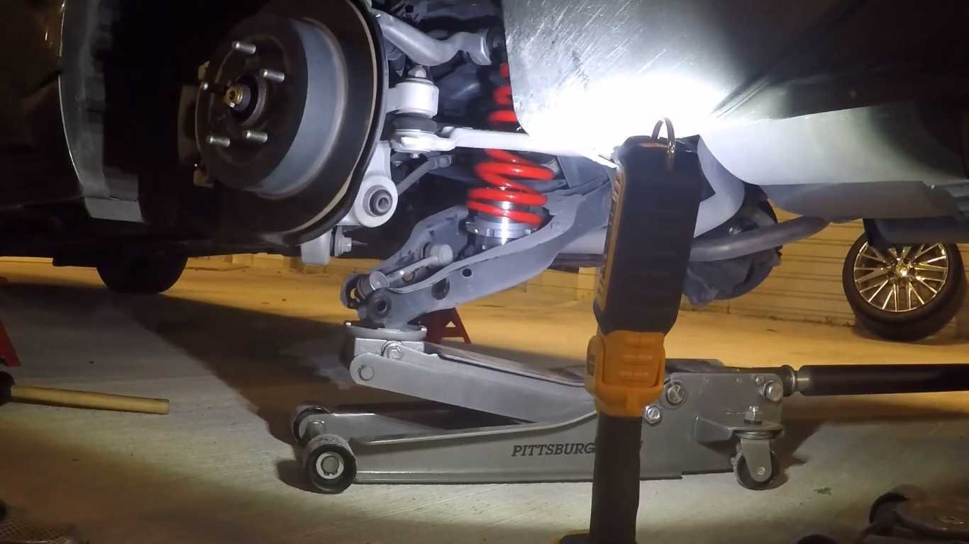
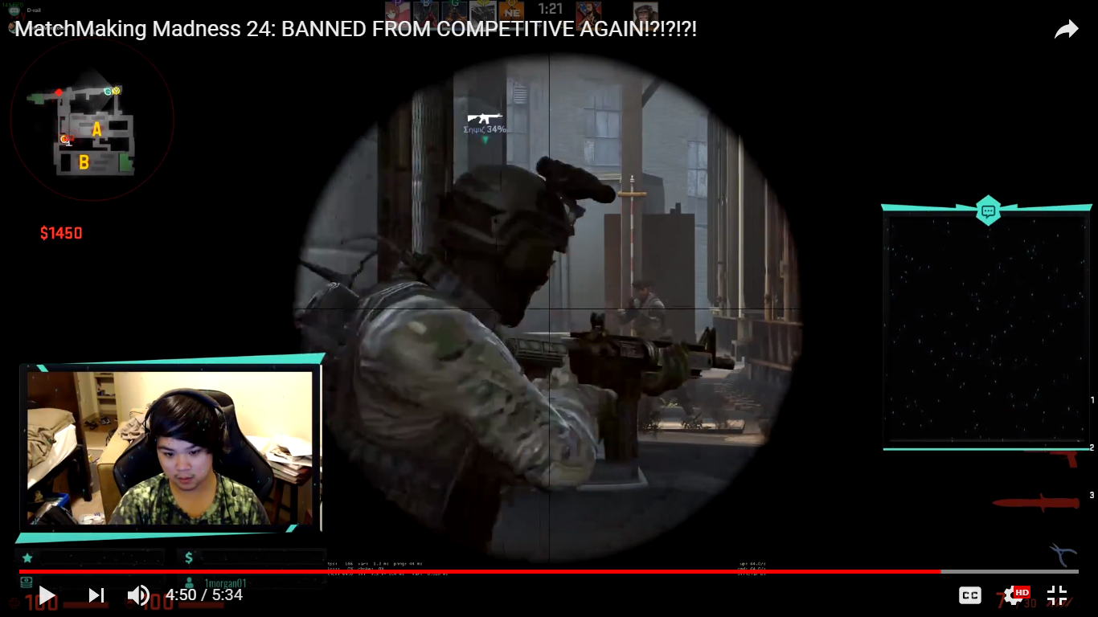
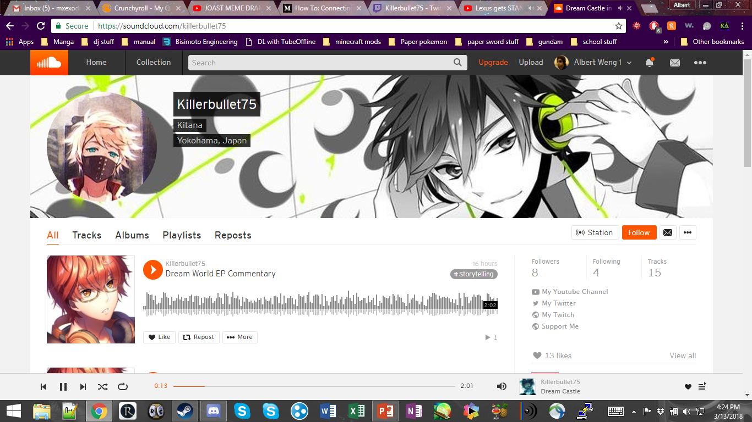
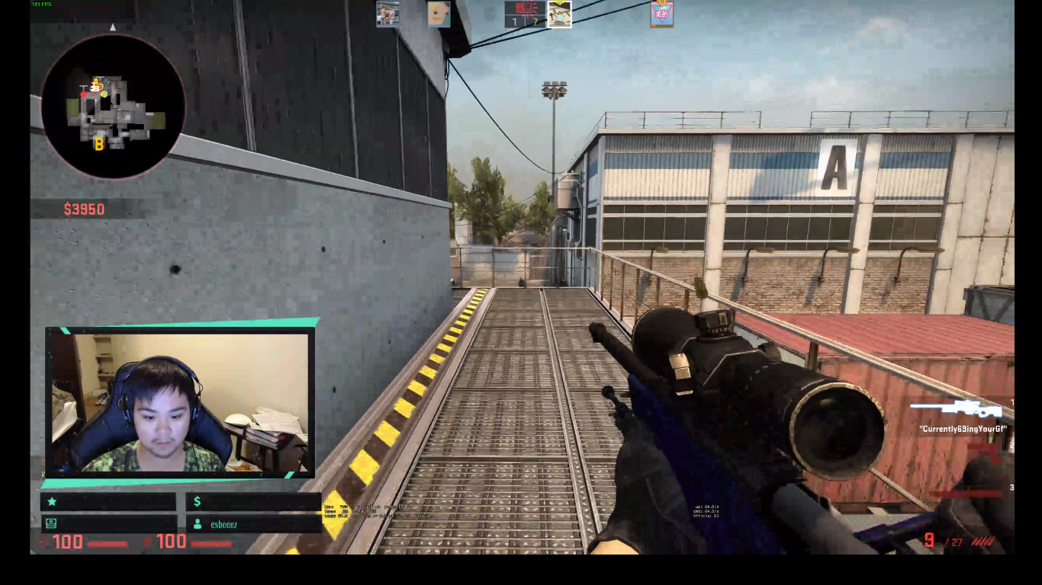
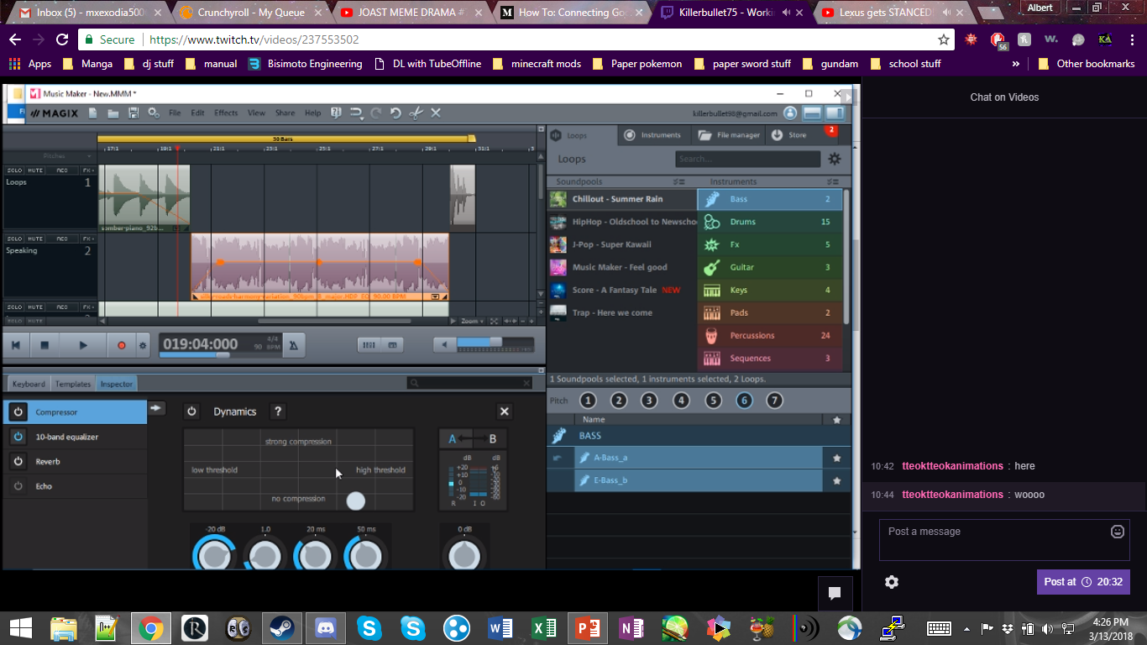


Slide 2

Nani The Fuck?!?!

Slide 3


Slide 4
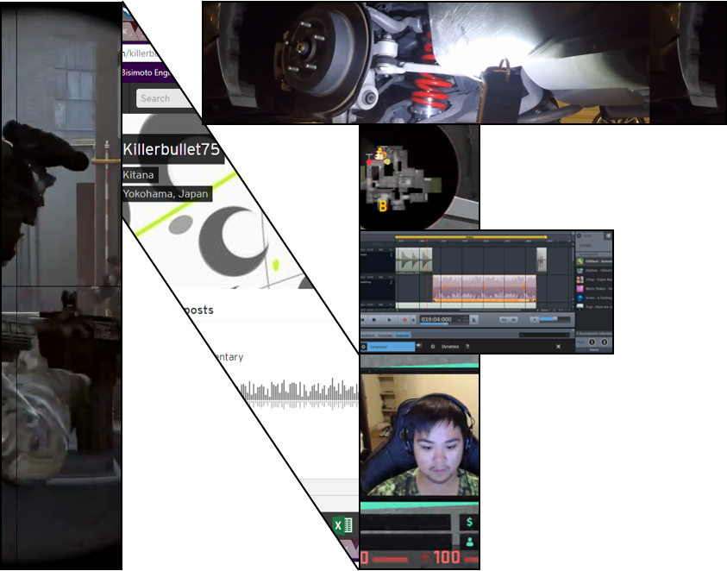
Nani The Fuck?!?! Content Creators

Slide 5
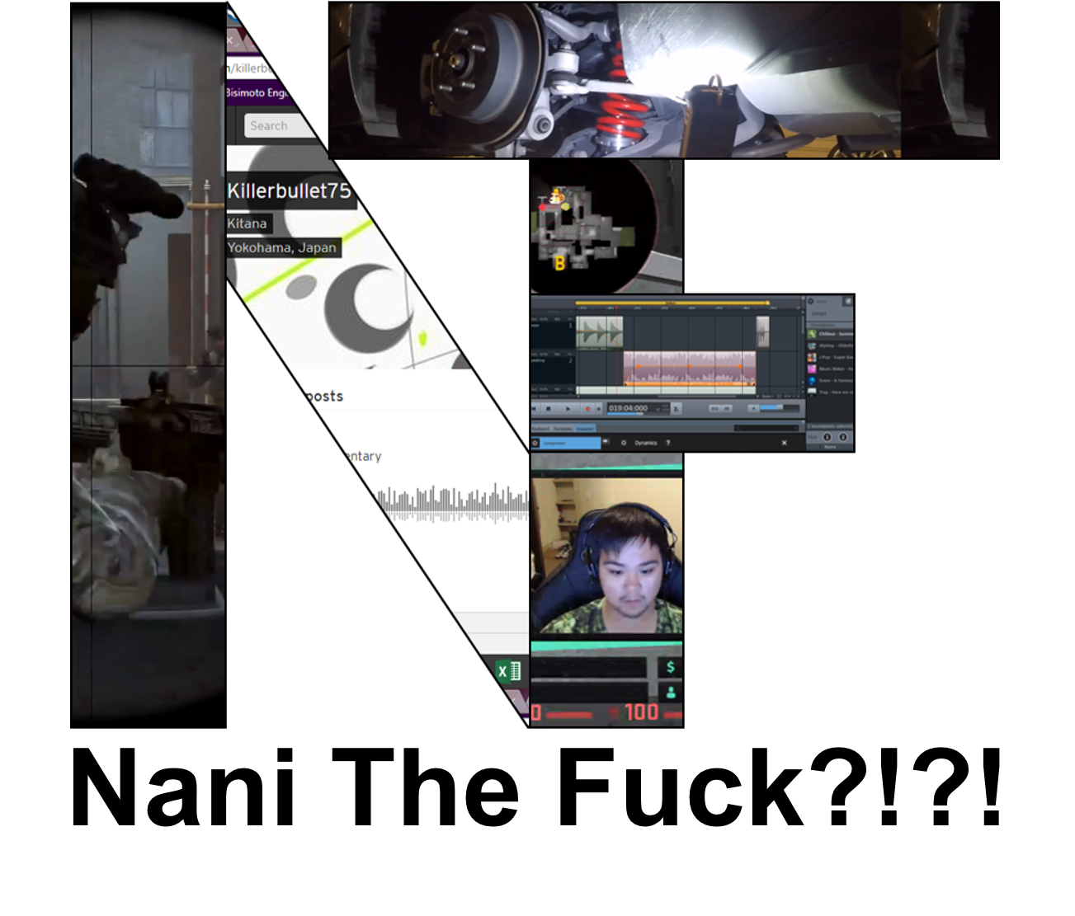

Slide 6


Welcome to the home of
Nani The Fuck?!?! Content Creators

Slide 7

Content
Creators

